Slide 1

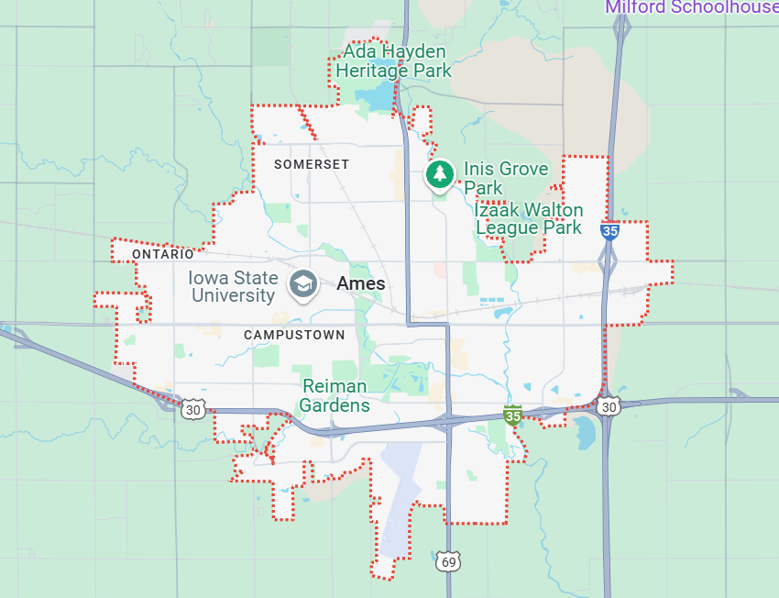
AMES HOUSING - IOWA
BU ABA Coding Challenge
Prabu Jeyabalan
REAL ESTATE

Slide 2

01
Data Overview:
This dataset covers the sale of 2,930 residential properties in Ames, Iowa, from 2006 to 2010. It includes a variety of variables—23 nominal, 23 ordinal, 14 discrete, and 20 continuous—all of which are used to predict the sale price of the properties.
PAGE 01
Abstract
02
Assumption:
The majority of buyers intend to purchase a home to live in with minimal renovations. Thus, factors such as the property's condition and features, along with its location, are important. If a complete reconstruction were the goal, only the location would matter, making the current condition irrelevant.
Based on this assumption, a customer looking to move to Ames City is interested to understand the market and what mostly influences the price.

Slide 3
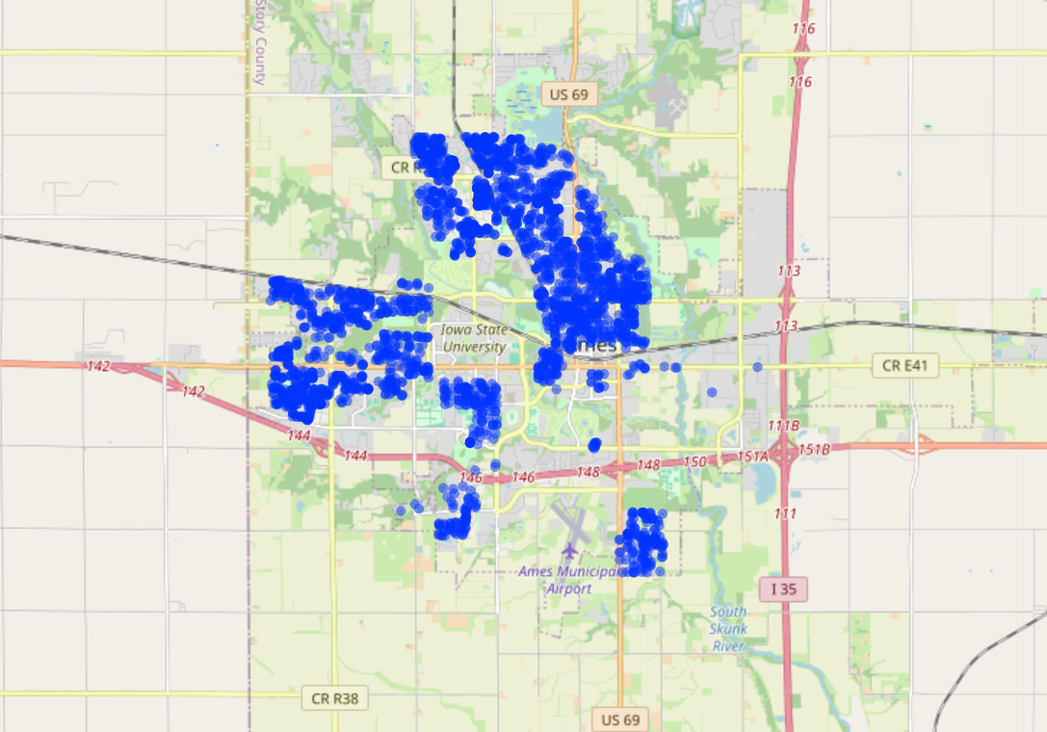
BU MET ABA HACKATHON | FALL 2024
Property Sale Types
&
Key Factors Influencing
Sale Price

Slide 4
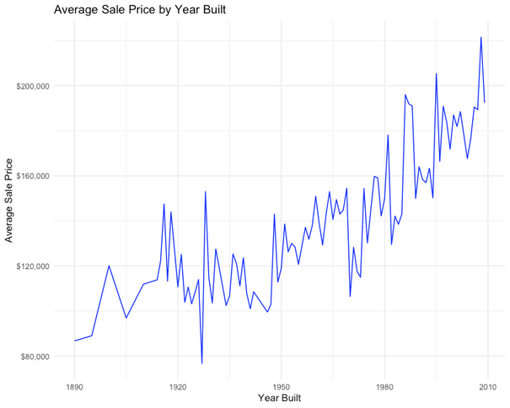
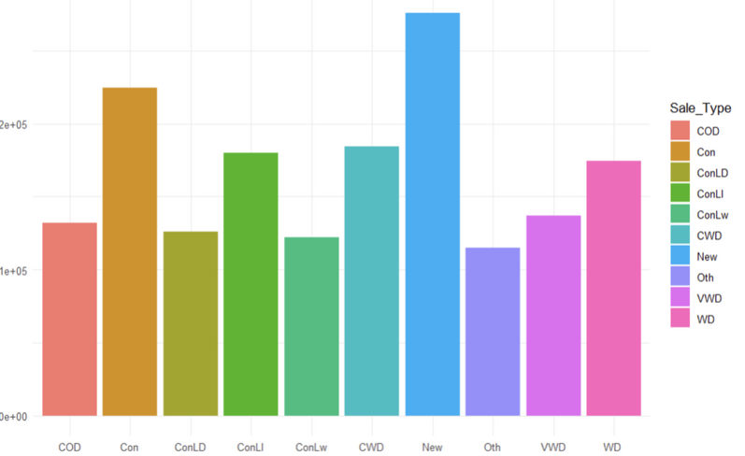
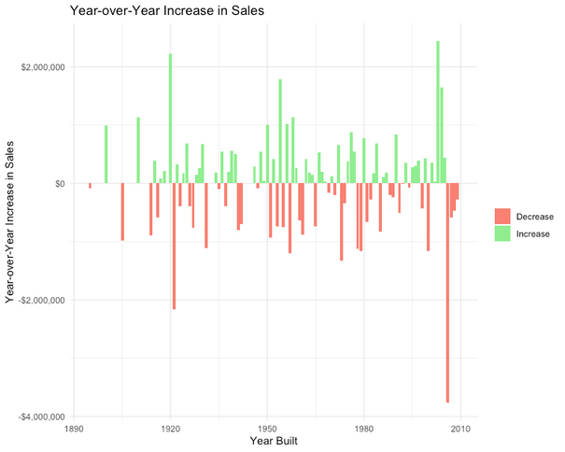
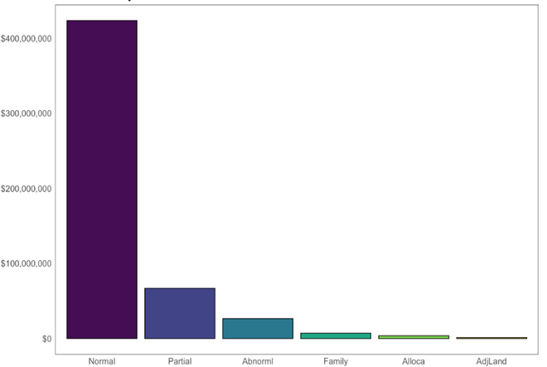
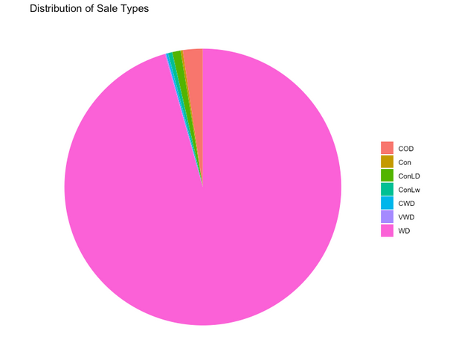
Dashboard
Average Sale Price
Dominant Sale Method
Price increases with time. Almost evey increase in price is followed by a decline in price.
Warranty Deed - Conventional is the dominant sale method with the mid-range price. New construction sales being the second most common with highest average price.
Most sales have a condition of Normal type.
$180,796.10
Warranty Deed - Conventional
Average Sale Price by Sale Type
Average Sale Price
Dominant Sale Condition
Normal (80%)
Sale Type
Total Sales by Sale Condition
Total Sales Amount
WD : 86.6%
Sale Condition

Slide 5
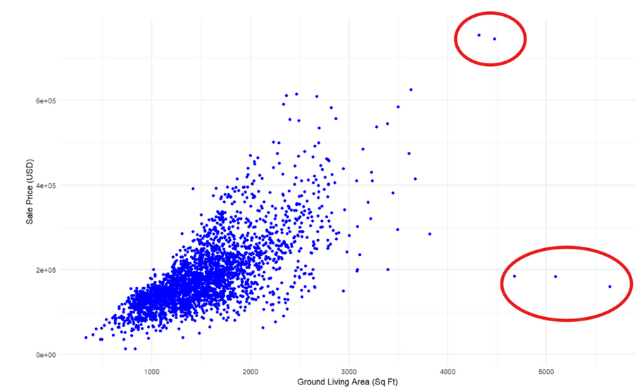
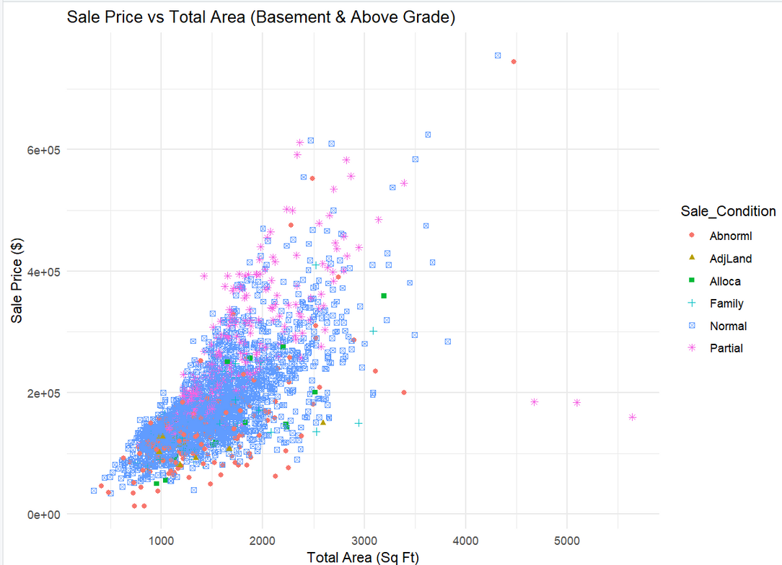
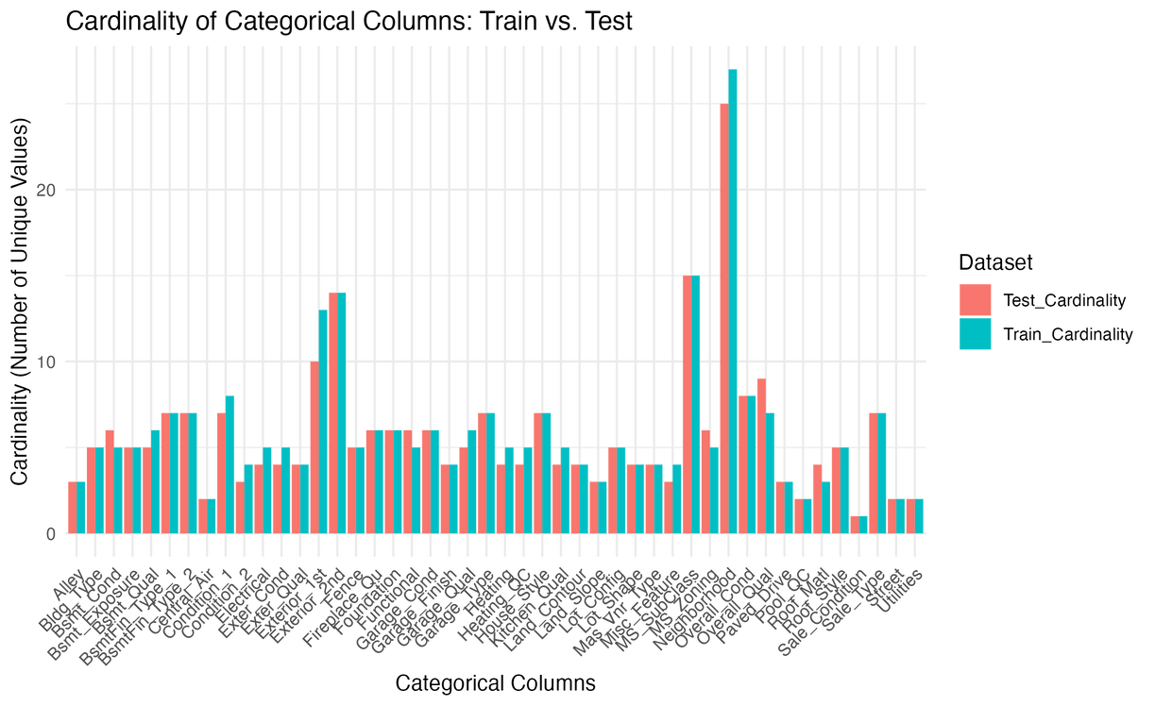
Special Notes on Data Filterings:
Relationship Between General Living Area (Sq Ft) and Sale Price)
Above grade (ground) living area square feet less than 1500
Sale Method as “Normal” only
Sale Price vs Total Area (Basement & Above Grade)
Cardinality of Train vs. Test columns

Slide 6
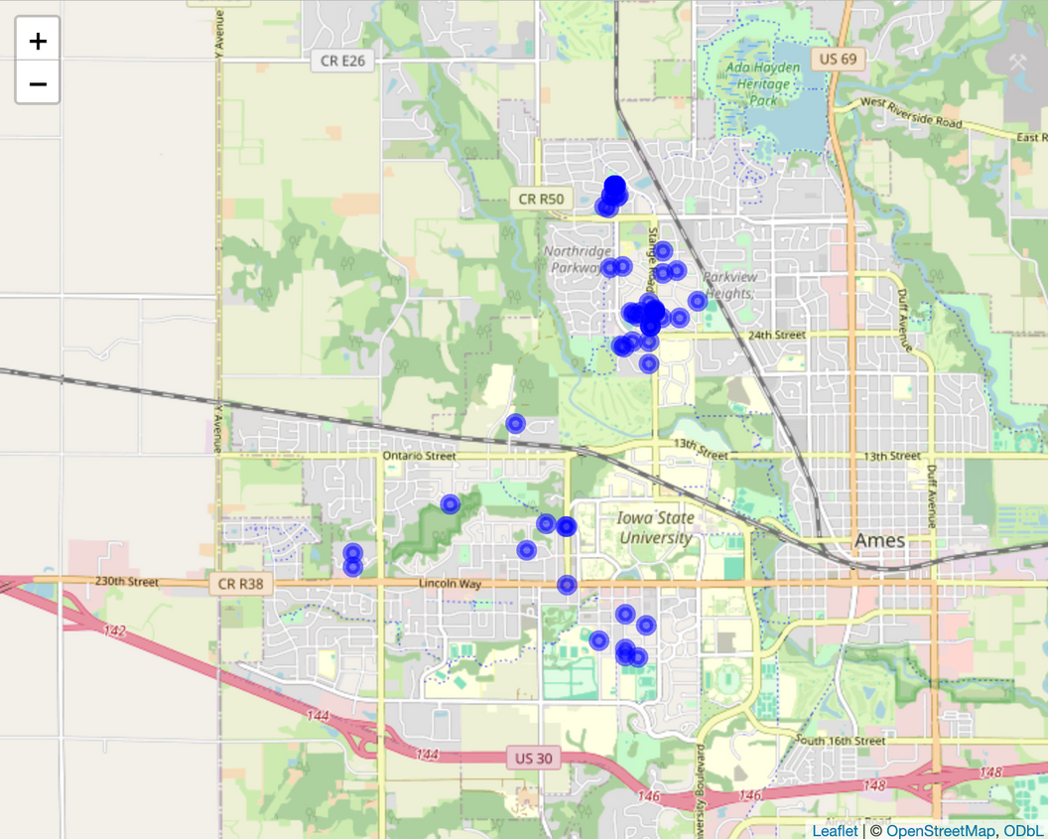
Location
Top 5 Neighborhoods: Veenker, Ckear Creek, Somerset, Northridge Heights and S-W of Iowa State University
All the expensive neighborhoods are grouped around two points, either to the north side or towards the Iowa State University.
Somerset and Northridge Heights are present in the northern area.
Iowa South-West of State University and the Clear Creek Neighborhoods are present in the southwest

Slide 7
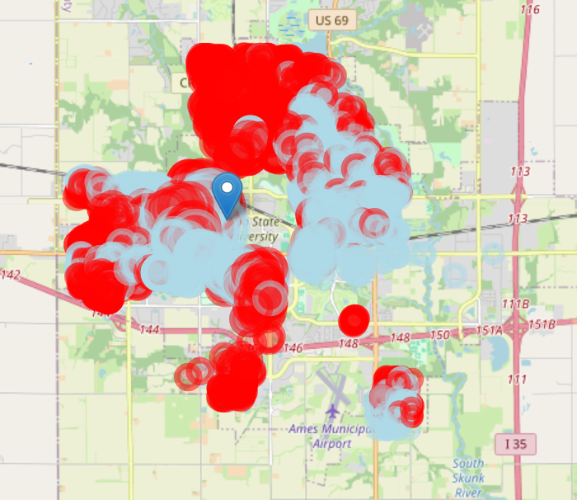
Location
Iowa State University: latitude and longitude as 42.02931225906169, and -93.65156268149819
Airport
Red for is applied to properties with a sale price greater than the median sale price
Blue is applied to properties with a sale price less than or equal to the median sale price
Properties near the northeast of Iowa State University and Highway 30 (red circles) tend to be more expensive, likely due to proximity to major transportation routes and the university.
Properties farther from the university, closer to Ames Airport (blue circles), tend to have lower sale prices, possibly due to noise pollution from airplanes.

Slide 8
Predictive Analysis

Slide 9
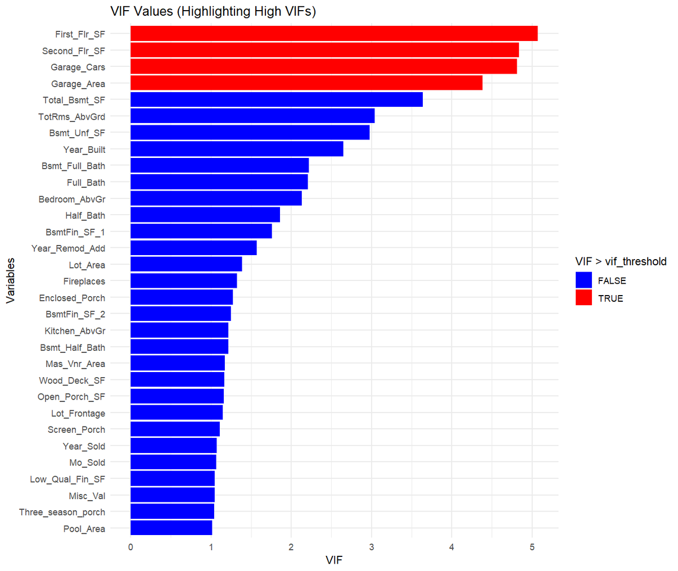
Multi-Linear Regression
Select numerical variables that are not highly correlated with each other.

Slide 10
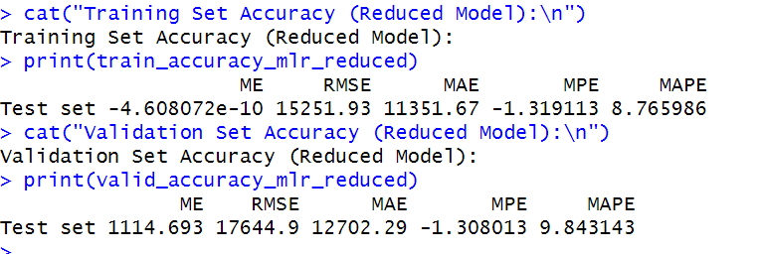
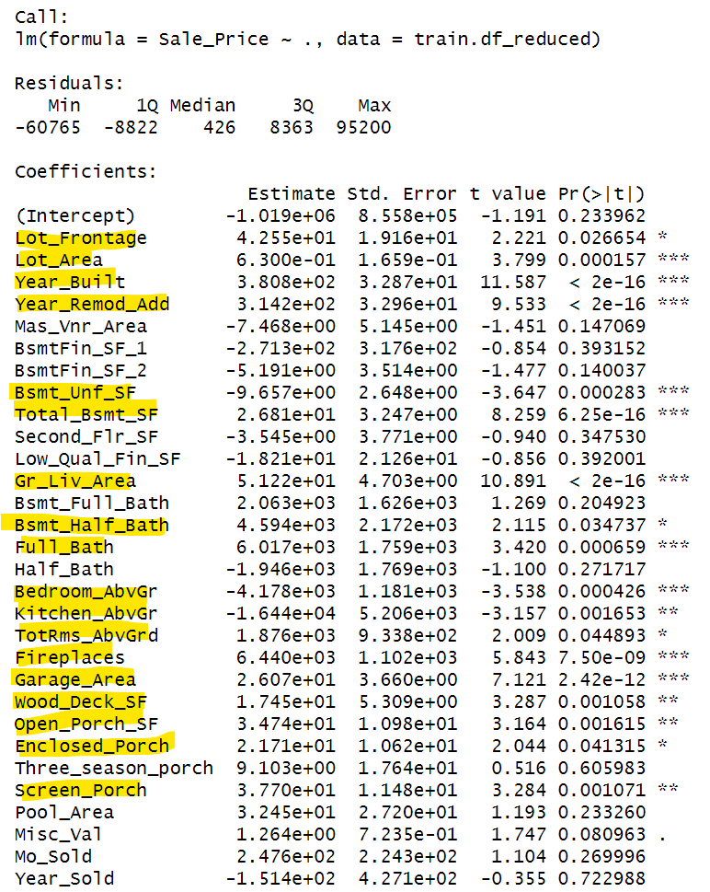
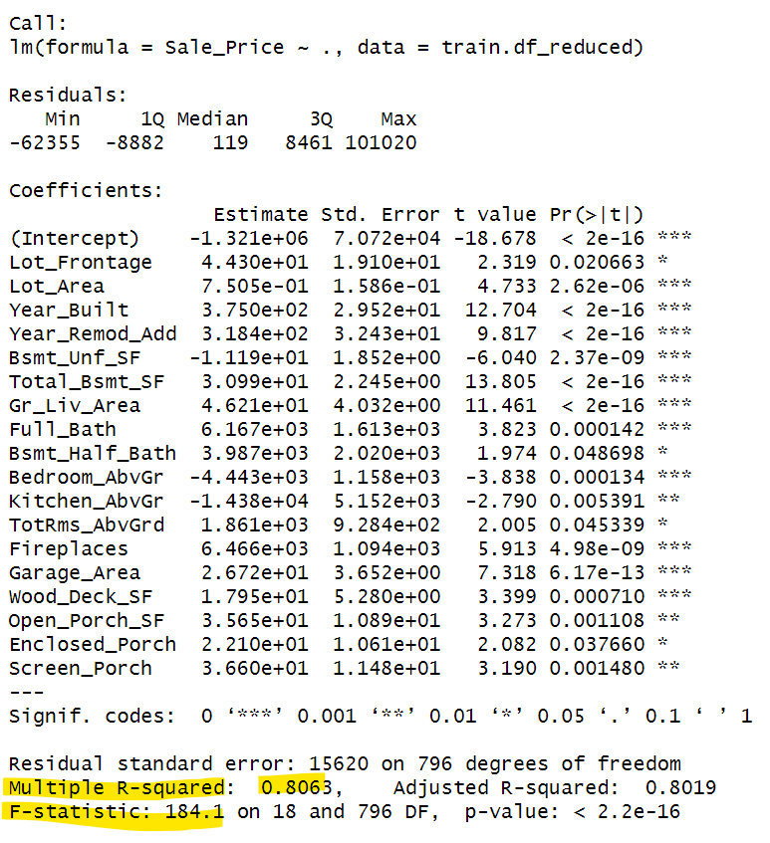
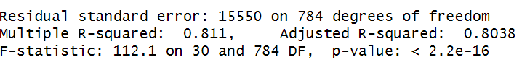
Multi-Linear Regression
The highlighted variables are the ones that are highly correlated with the target variable (Sale_Price).

Slide 11
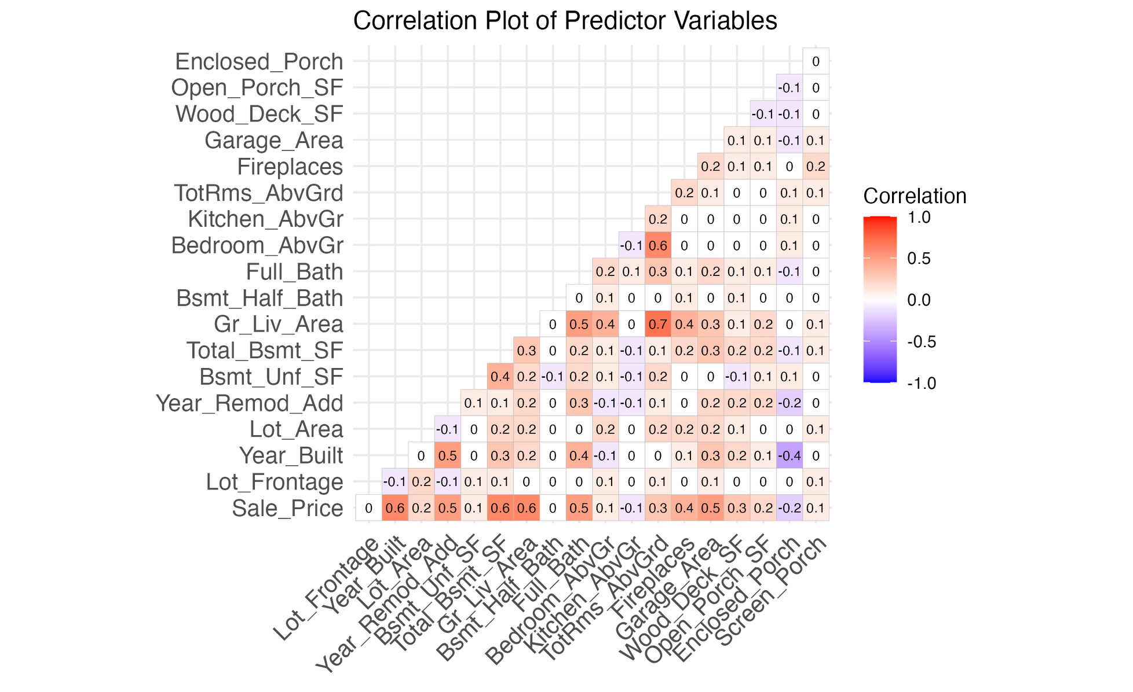
Correlation of Predictor Variables
Year Built, total basement square footage, and general living area are important features contributing to the sale price

Slide 12

Clustering
Ordinal Categorical Variables &
Numerical Variables

Slide 13
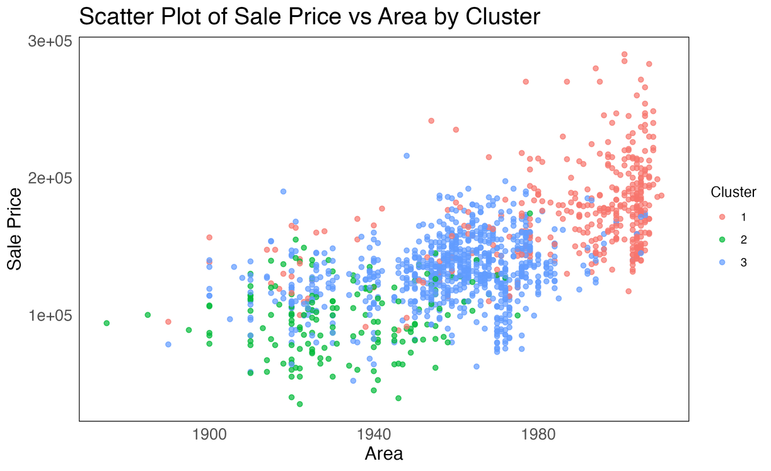
Findings
Ordinal Categorical Variables
The model's price is influenced by Garage Quality and Overall Quality; as these values rise, the total price increases. Additionally, having a fence is a requirement, and Central Air conditioning is always included. However, factors such as Basement Quality, Heating Quality, and Kitchen Quality are not of concern.
Lux
Economic
Average
Cluster | Overall_Qual | Bsmt_Qual | Heating_QC | Central_Air | Kitchen_Qual | Garage_Qual | Fence
Lux | 6.53 | 2.99 | 1.67 | 1 | 3.48 | 5.94 | 4.86
Average | 5.2 | 5.41 | 3.53 | 1 | 4.7 | 5.88 | 4.1
Economic | 4.43 | 4.99 | 3.35 | 0.34 | 4.24 | 3.74 | 4.48

Slide 14
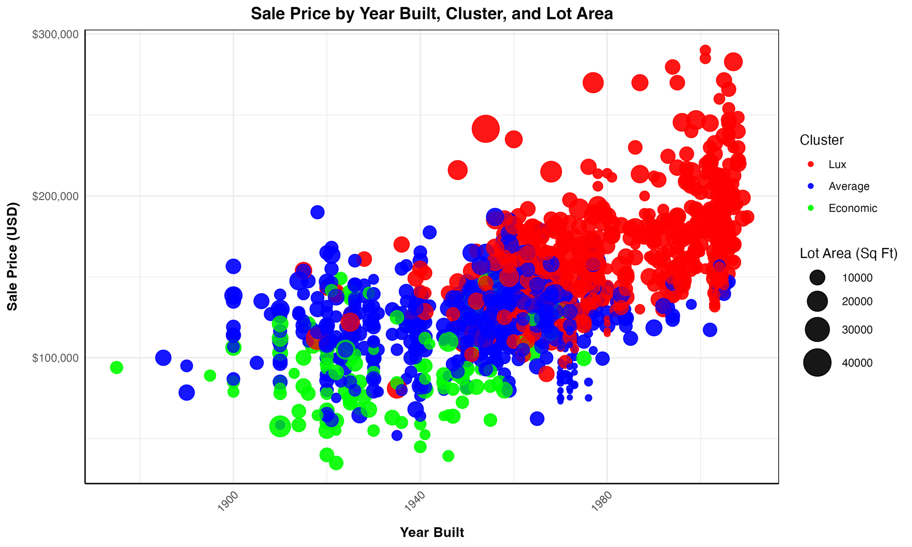
Findings
Numerical Variables
The Lux cluster represents more modern homes with higher prices, likely due to the incorporation of newer features like central air conditioning.
The Average cluster falls between Lux and Economic in terms of price and construction dates.
The Economic cluster includes homes with the lowest prices, and smaller lot areas.
World War II and great depression (1939-1945).

Slide 15
Key Insights
Location:
Focus on developing or marketing properties in higher-value locations like properties near the northeast of Iowa State University and Highway 30.
Certain Home Features that Affect Sale Prices Are:
Highlighting key features like basements, living areas, bathrooms, bedrooms, kitchens, lot size, year built, fireplaces, garages, and wood decks can positively influence the sale price. Emphasizing these features in listings can attract higher bids.
The cluster can give us insight into the type of listings to be shown thinking on different customers needs. Tailoring sales pitches and pricing strategies can then be implemented according to clustering the insights; such as for high-end buyers, target the Lux cluster, which has properties with the highest quality and garage space.
Clusterings:

Slide 16
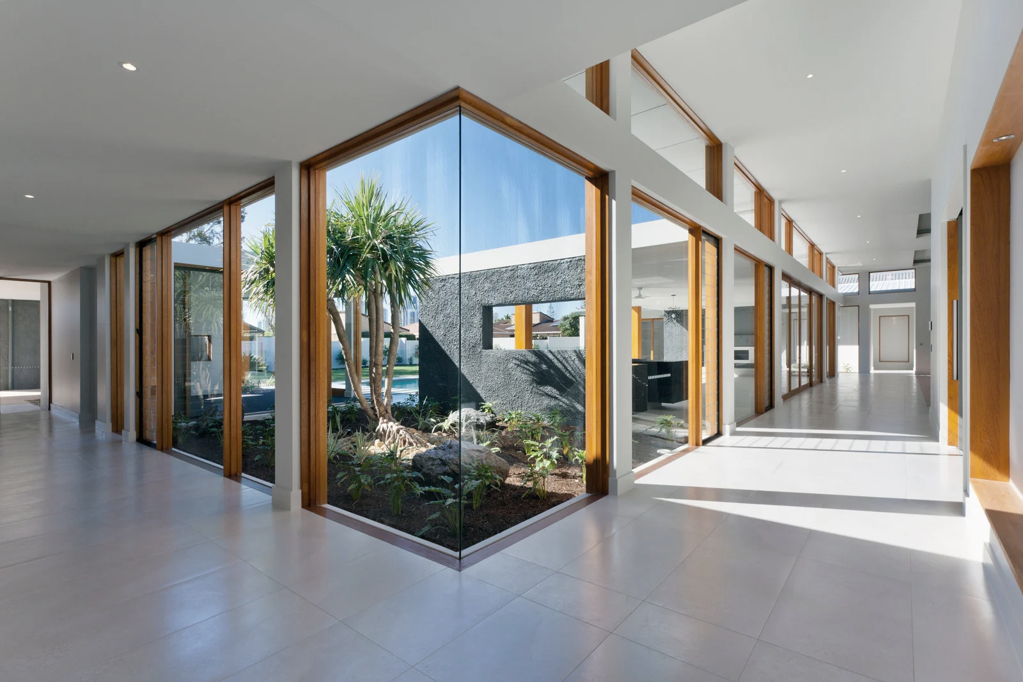
Thank You For Your Attention!

Slide 17

BU MET ABA HACKATHON | FALL 2024
PAGE 12
Resources:
History of air conditioning: A brief HVAC history - when & how {timeline}. Trade School Programs in Chicago. (2022a, May 23). https://www.coynecollege.edu/a-brief-history-of-hvac-air-conditioning/#:~:text=What’s%20the%20story%20of%20the,built%20with%20central%20air%20conditioning
Wolfeco. (2023, February 14). A look back at the housing market: From the 1920s to Today. Winter Homes. https://www.builtbywinterhomes.com/news/a-look-back-at-the-housing-market/#:~:text=The%201940s:%20A%20Decade%20of,of%20the%20previous%20two%20decades.
World War II. Iowa PBS. (n.d.). https://www.iowapbs.org/iowapathways/mypath/2555/world-war-ii#:~:text=The%20second%20world%20war%20in,in%20a%20variety%20of%20ways

Slide 18
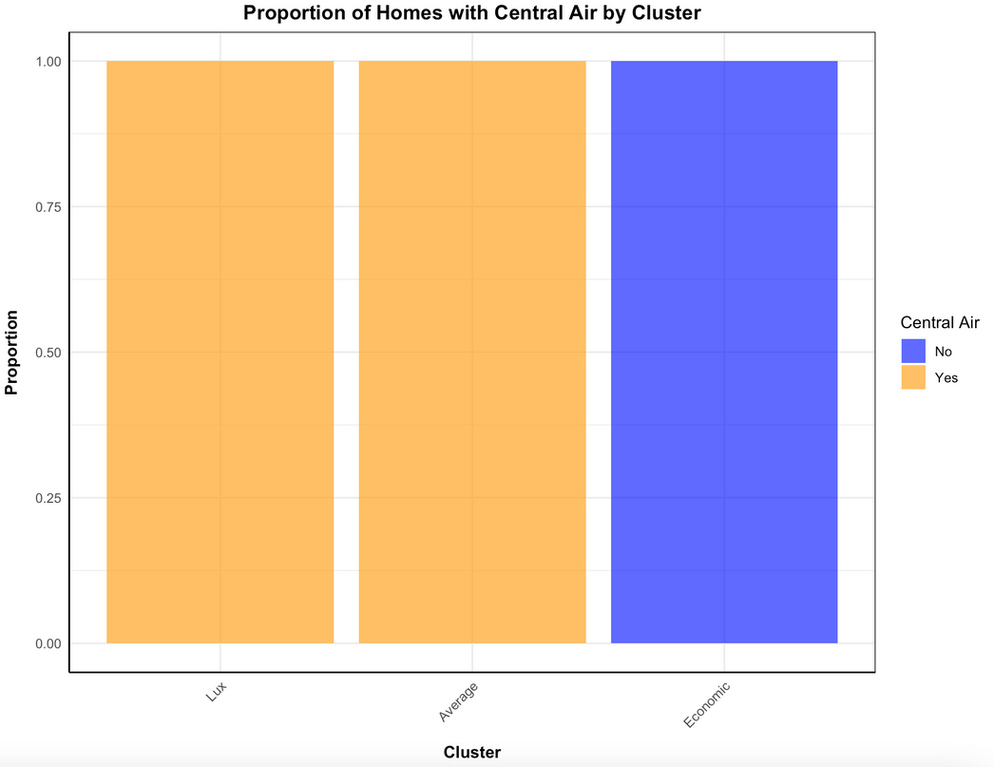
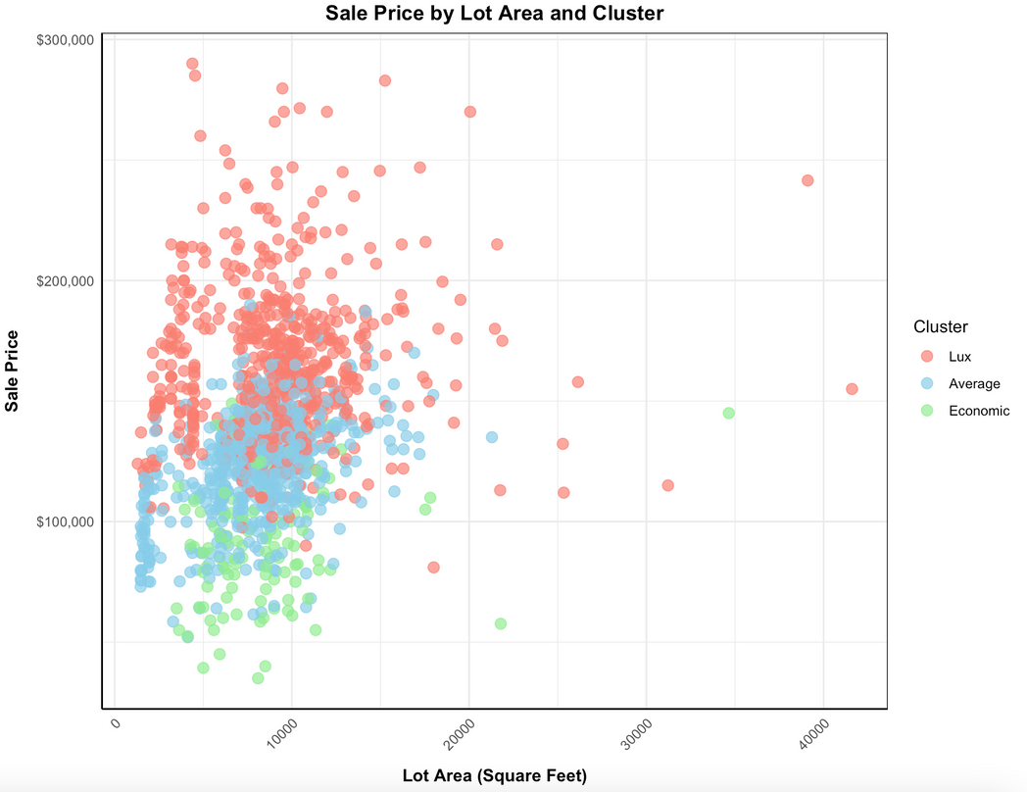
Appendix
Clustering with Numerical Variables
selected_features <- data_1 %>%
dplyr::select(Lot_Area, Year_Built, Central_Air) %>%
mutate(Central_Air = ifelse(Central_Air == "Y", 1, 0))

Slide 19
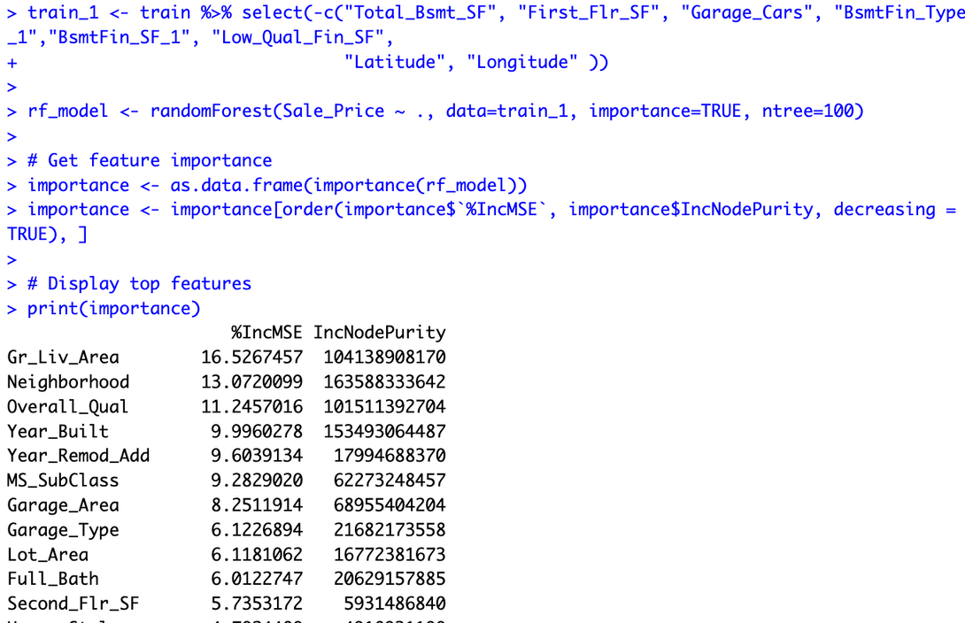
RFM:
What are the most important ones?

Slide 20
